Slide 1

STULZ-CHSPL INDIA
Date:
INTERNSHIP REVIEW
IT Department
Team members
Mentor
DIvya Junghare
Sumit Rai
V. Srinivasan
Deepta Panda

Slide 2

BACKGROUND
Processed historical machine breakdown data to identify failure patterns.
Used Python, Pandas, and Scikit-learn within Jupyter Notebook for analysis and modeling.
Focused on failure prediction to enable early detection and minimize service disruption.
Analyzed breakdown ticket data to understand root causes and resolution timelines.

Slide 3
PROJECT GOALS
Predict machine failures in advance using data-driven insights.
Develop a Machine Learning model that supports proactive maintenance decisions.
Reduce unplanned downtime and operational risks through timely interventions.
Provide actionable intelligence to maintenance teams for resource optimization.

Slide 4
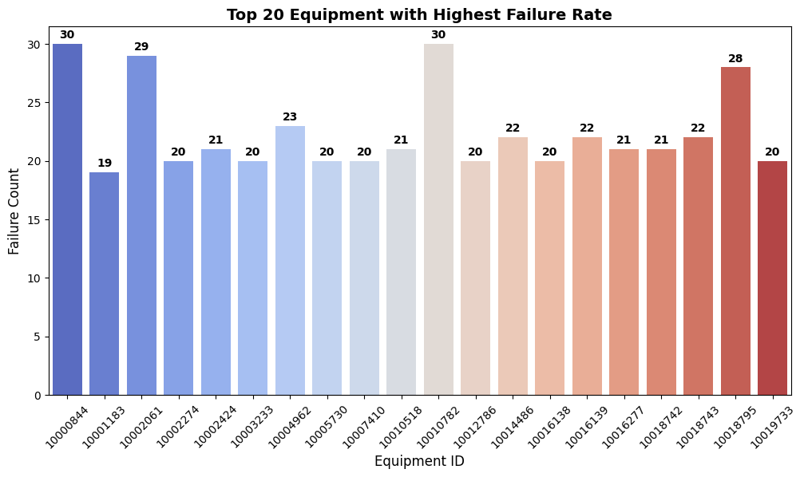
DATA ANALYSIS INSIGHTS
1. Top 20 Failed Equipment
Highlights the equipment with the highest failure count, guiding preventive maintenance prioritization.
Targeting these assets can reduce downtime and enhance operational reliability.

Slide 5
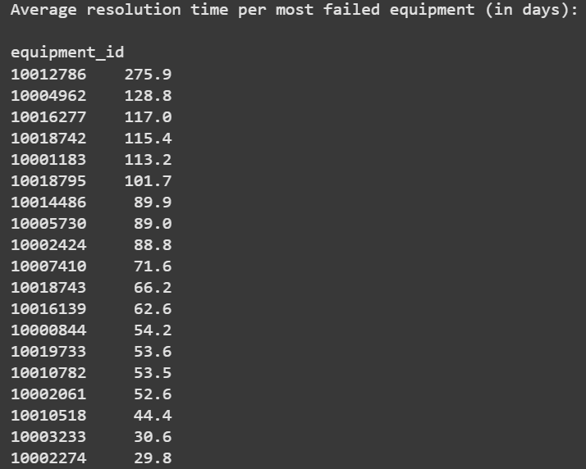
DATA ANALYSIS INSIGHTS
2. Average Resolution Time per Equipment
Shows average repair duration per equipment to identify delays in service closure.
Long resolution times suggest the need for process improvement or better spare availability.

Slide 6
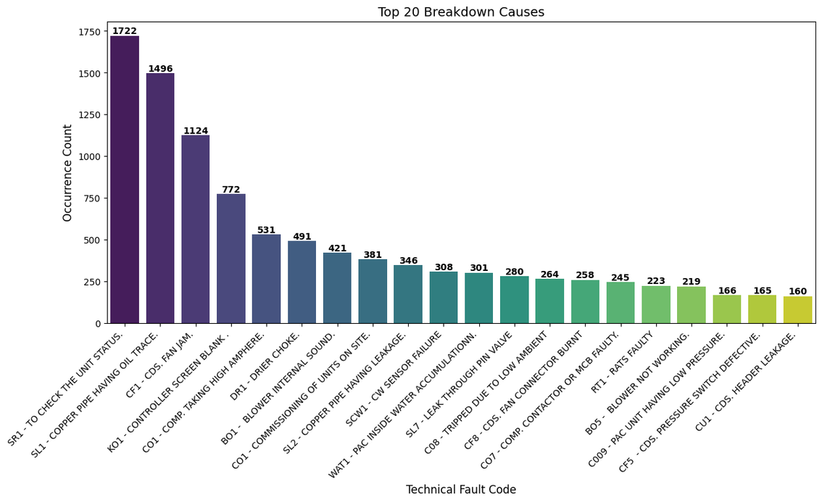
DATA ANALYSIS INSIGHTS
3. Most Frequent Breakdown Causes
Lists top recurring fault codes, revealing dominant failure types.
Enables training or design modifications to reduce repeated breakdowns.

Slide 7
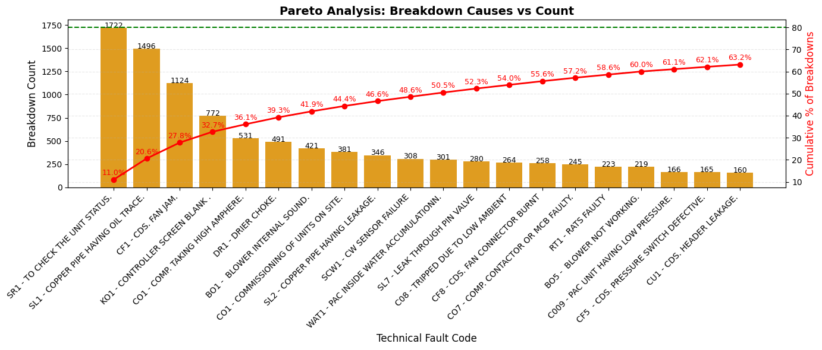
DATA ANALYSIS INSIGHTS
4. Pareto Analysis (80/20 Rule)
Demonstrates that 20% of fault codes cause nearly 80% of failures.
Prioritizing these key issues can deliver maximum impact with minimal effort.

Slide 8
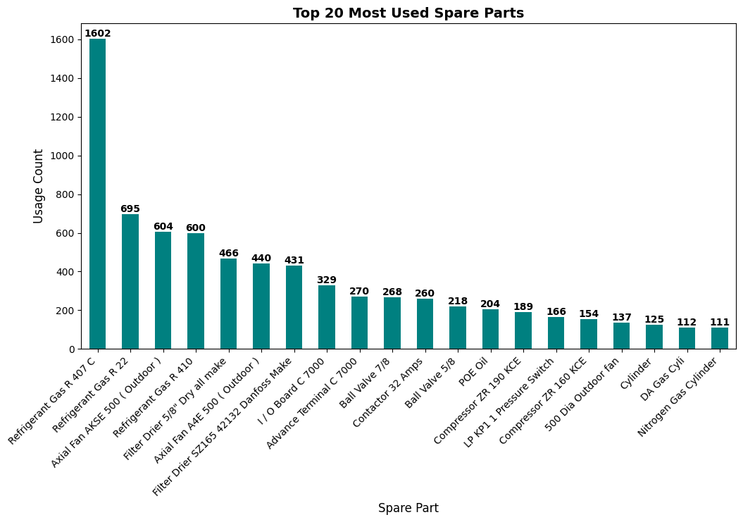
DATA ANALYSIS INSIGHTS
5. Most Spare Parts Consumed
Displays the most frequently used spares, highlighting high-demand components.
Aids in inventory planning and identification of wear-prone parts.

Slide 9
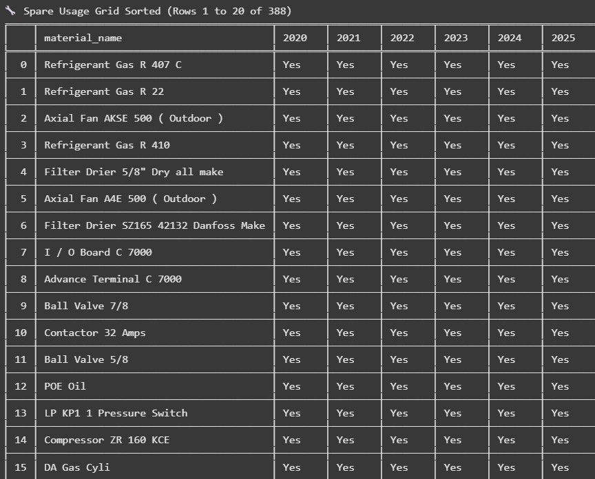
DATA ANALYSIS INSIGHTS
6. Year-Wise Spare Consumption Analysis
Tracks spare usage across years and ranks by frequency and recurrence.
Supports long-term procurement strategy and highlights critical inventory.

Slide 10
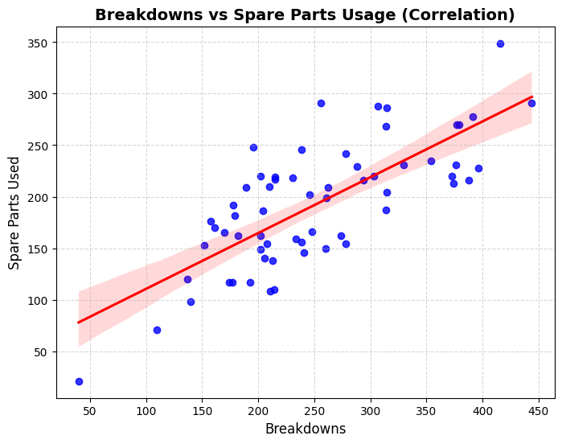
DATA ANALYSIS INSIGHTS
7. Breakdown Trend Over Time
Visualizes monthly breakdown and spare trends with correlation metrics.
Enables predictive planning and validates the link between faults and consumption.
Correlation between breakdowns and spare parts usage: 0.75

Slide 11
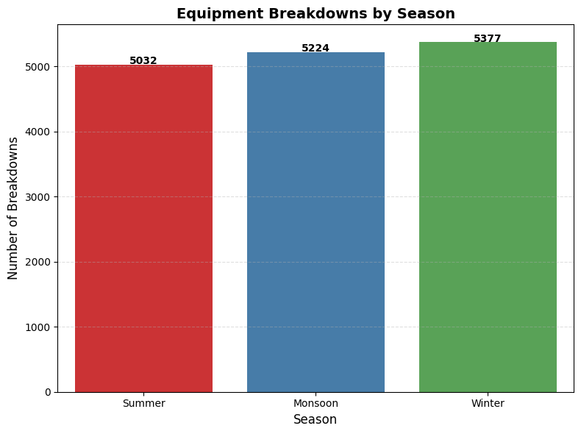
DATA ANALYSIS INSIGHTS
8. Seasonal Breakdown Analysis
Categorizes breakdowns by season (Summer, Monsoon, Winter).
Helps allocate workforce and schedule maintenance as per seasonal stress.
Summer: Feb, Mar, Apr, May
Monsoon: June, July, Aug, Sep
Winter: Oct, Nov, Dec, Jan

Slide 12
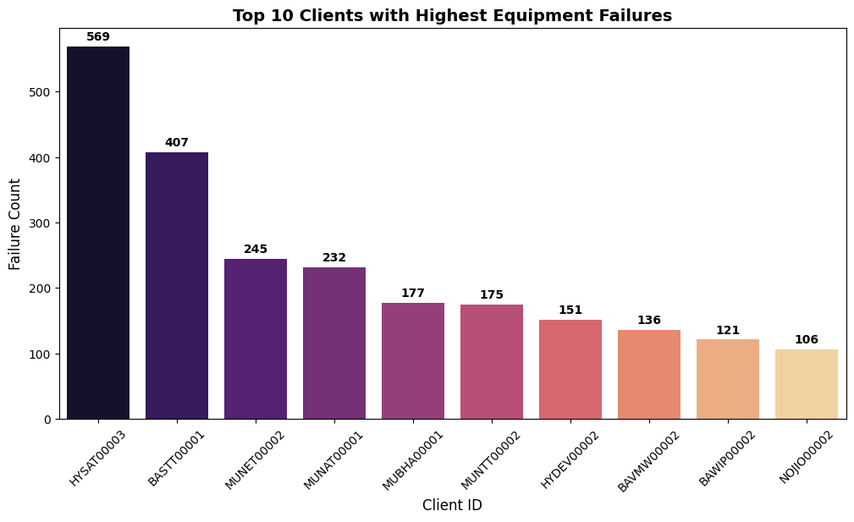
DATA ANALYSIS INSIGHTS
9. Client-Based Breakdown Analysis
Identifies clients with the highest number of failures.
Enables client-focused reliability improvements and support planning.

Slide 13
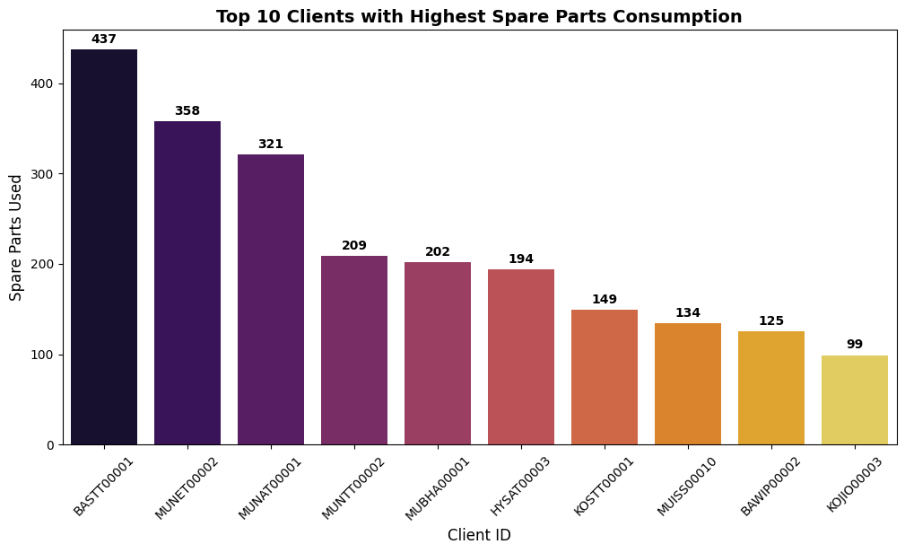
DATA ANALYSIS INSIGHTS
10. Spare Part Consumption Across Clients
Shows top clients by spare usage to track demand sources.
Informs stocking, service agreements, and revenue optimization.

Slide 14
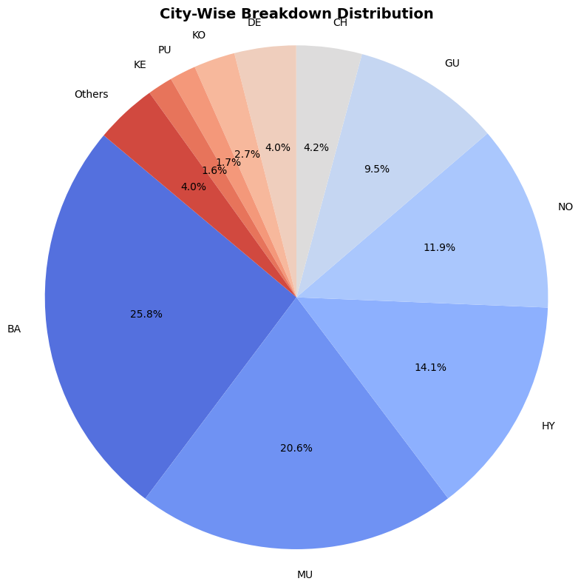
DATA ANALYSIS INSIGHTS
11. City-Based Breakdown Analysis
Pie chart of failures by city grouped.
Assists in regional resource allocation and field team deployment.

Slide 15
THANK YOU

